Slide 1
Pilot exercise and training session on conducting point prevalence surveys
Organised by Joseph Acolatse
6th December 2022

Slide 2
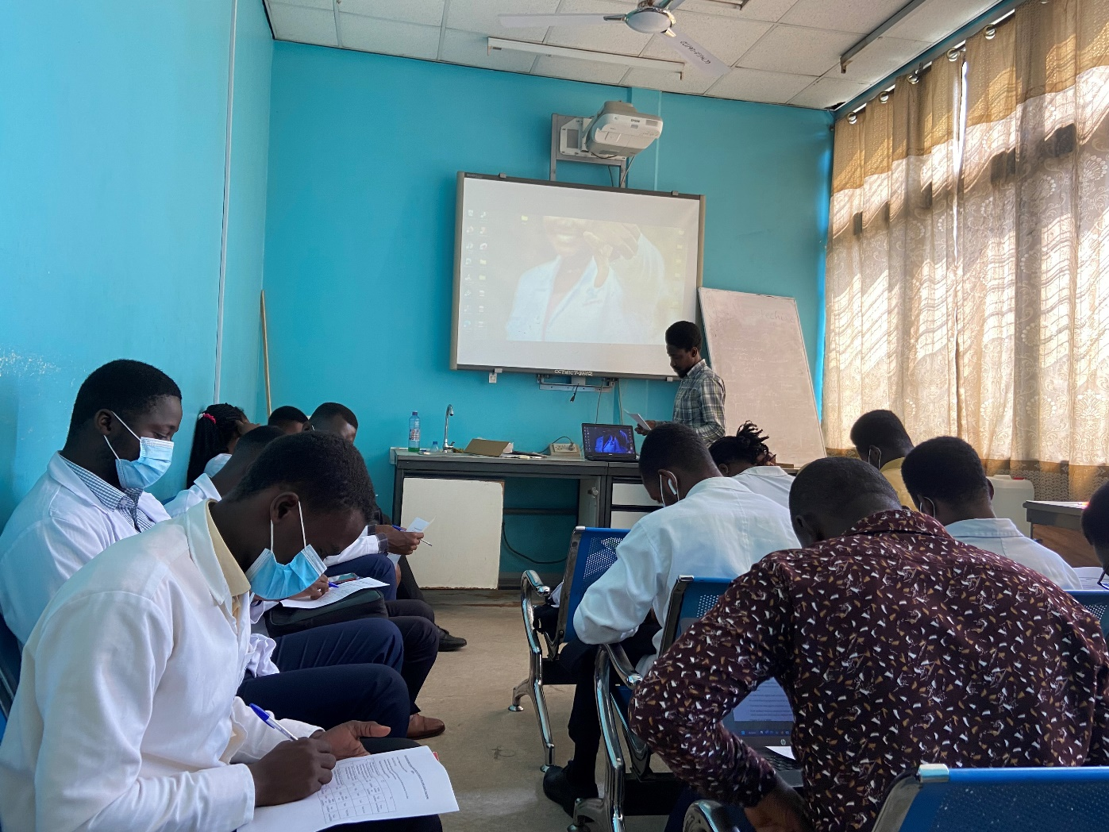

Slide 3
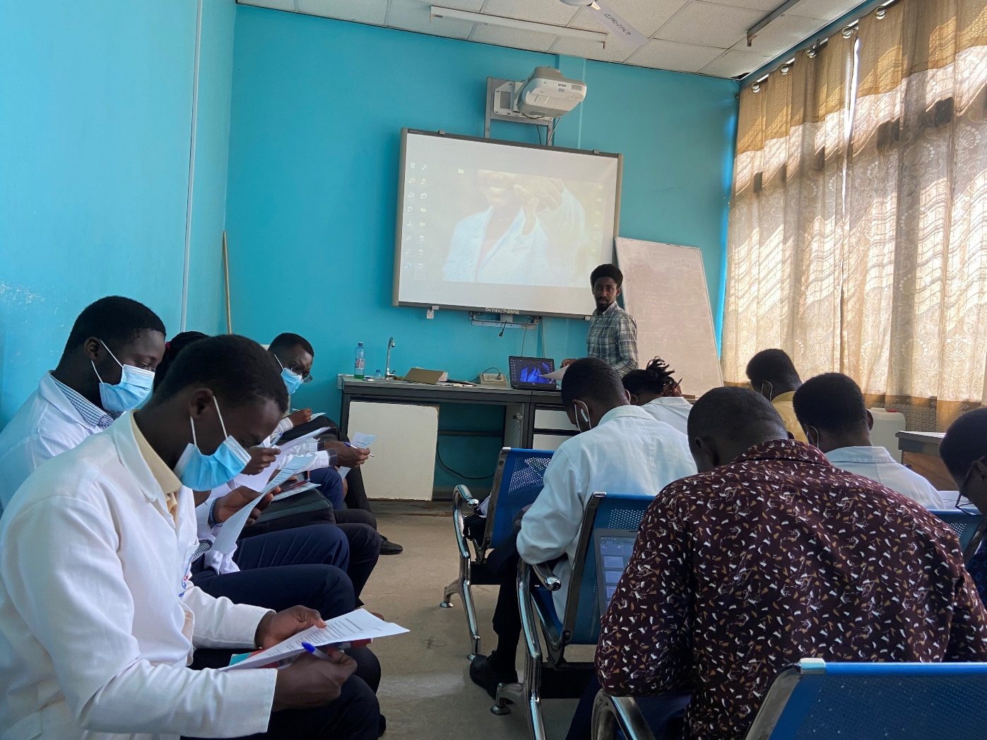

Slide 4
